Slide 1
MATH TRAINING
Education | Hack The Mountains 2.0

Slide 2
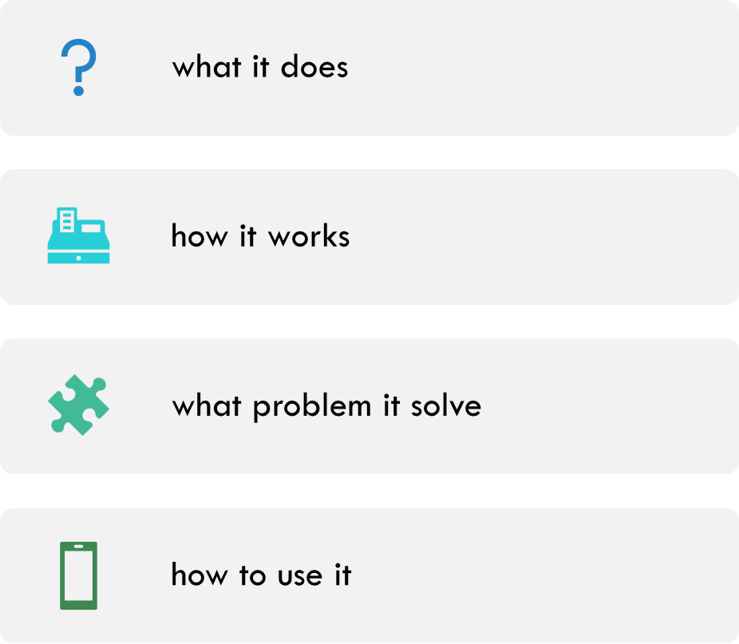

Slide 3
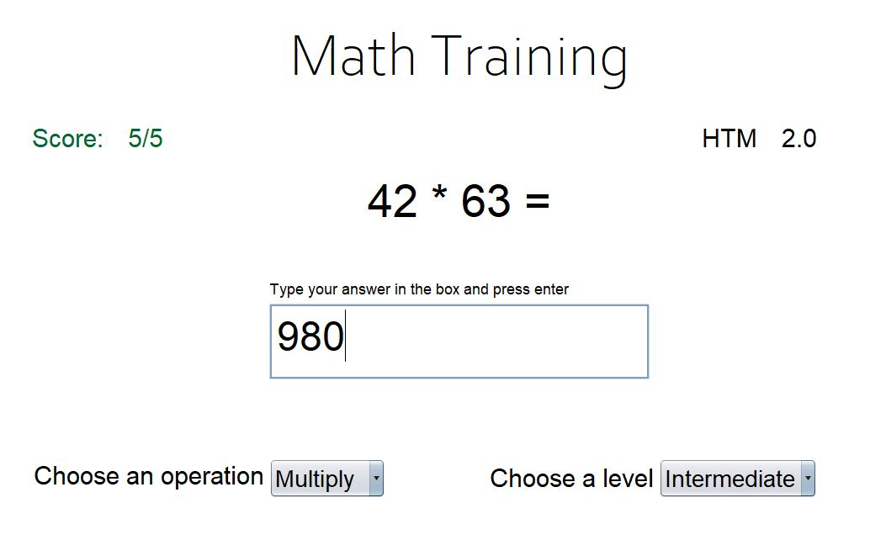
WHAT IT DOES?
Gamify math. Improve your mental calculation skills

Slide 4
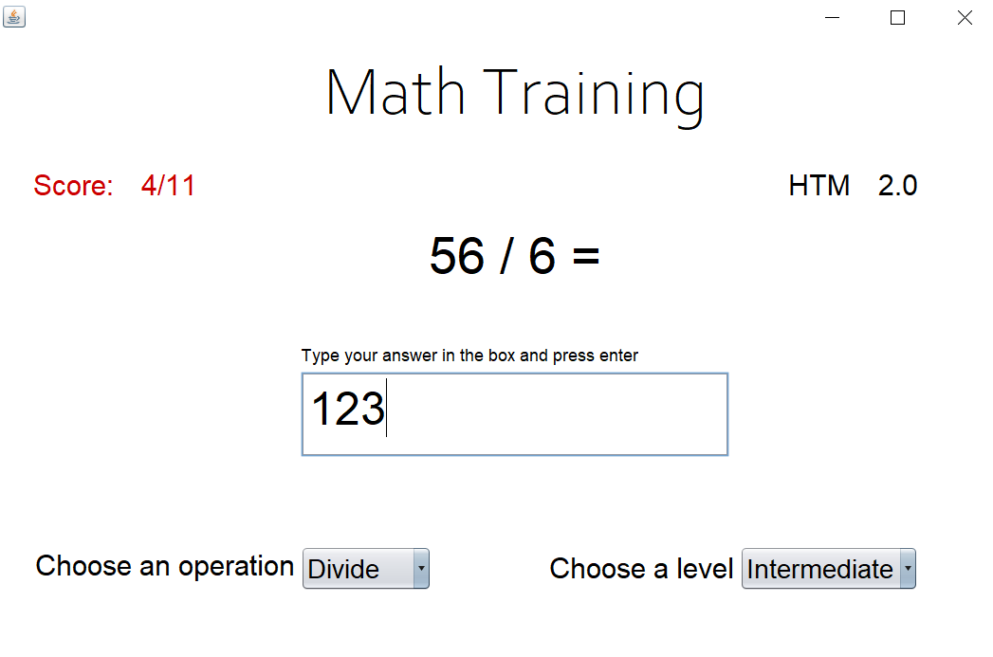
HOW IT WORKS?
The program shows and operation and to answer just type the answer and press enter

Slide 5
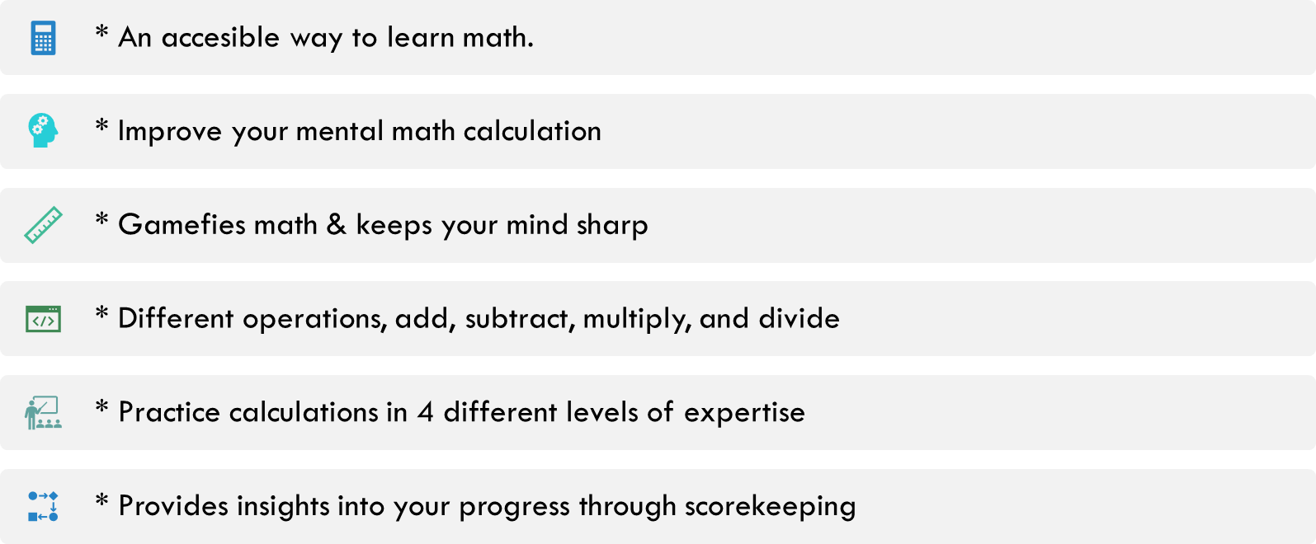
WHAT PROBLEM DOES IT SOLVE?

Slide 6
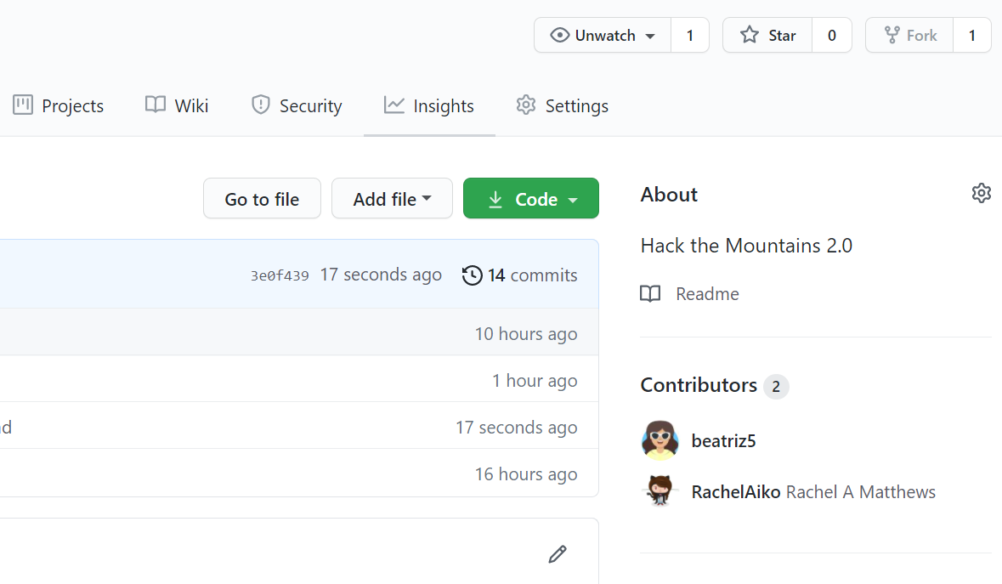
HOW TO USE IT?
Code available on github
Fork and run the program
https://github.com/beatriz5/math-training

